Slide 1
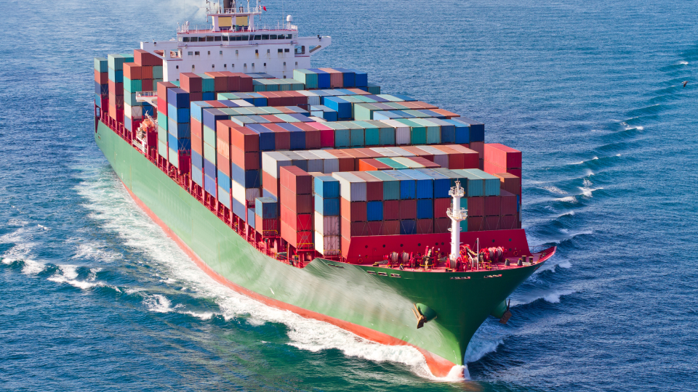
UK - US Great Lakes Seaway
A Strategic & Resilient Supply Chain
Jan Bauer, Consul
UK Government Office, Minnesota
Jan.Bauer@fcdo.gov.uk

Slide 2

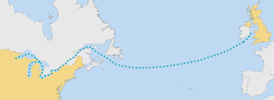
UK/US/CA Trade Route via the Great Lakes SLS
The St. Lawrence Seaway provides a direct maritime connection
Better utilize of the GL SLS system for UK-US trade
Improve the smooth efficient movement of goods while reducing carbon emissions

Slide 3
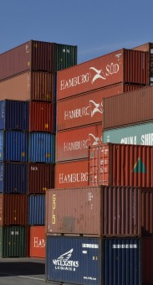
GLS Trade Route - Economic Advantage
This trade route delivers-
Clear, Measurable Economic Value
    Drives port growth,
    Increases high‑value cargo volumes
    Stimulates private investment
    Creates jobs
    Strengthens resilience
    Supports long‑term sustainability & competitiveness.
Strategic addition to the global trading network
Deeper UK–U.S. economic collaboration

Slide 4
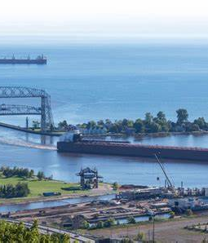

Recent UK Visit Outcomes
Deepened Engagement:
Strengthened collaboration across government, port authorities, carriers & exporters, reinforcing shared commitment to resilient inland trade routes
Acceleration of Commercial Activity:
Converted discussions directly into action, with Ports & Exporters now advancing confirmed and emerging cargo flows via the GLS system
Strengthened Port‑to‑Port & Industry Collaboration: UK & GLS ports have moved into operational coordination, supporting commodity linked supply chains, specialized bulk & and containerized cargo

Slide 5



Key Take Aways
Strategic Route Value: The GLS is a credible corridor into North America’s industrial & agricultural core, avoiding congested coastal gateways.
Geopolitical Relevance: The route offers a stable, trade corridor linking the UK, Canada and the US at a time of heightened geopolitical risk, pressure on major shipping lanes, and increased focus on diversified supply chains.
Resilience & Optionality: The Seaway complements existing routes, adding redundancy and flexibility to UK–US trade flows rather than creating dependence on a single corridor.
Scalable, Low‑risk Growth: Existing carrier models allow incremental and steady scale‑up without large full-scale commitments.
Future‑proofing Logistics: Early engagement supports planning for long‑lead logistic needs linked to future major events, such as the World Expo 2031.
This Photo by Unknown Author is licensed under CC BY-NC

Slide 6
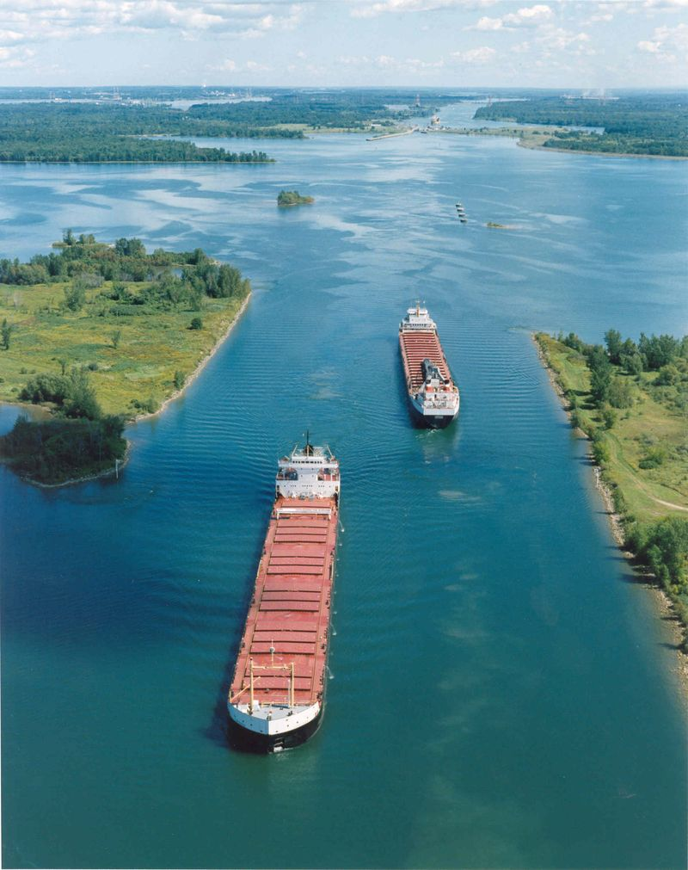
Next steps under consideration
Maintain Momentum: Who & How?
Technical mission? Industry workshop?
What best enables delivery & scaling?
Other ideas???
Embed Strategic & Resilient planning: Position GLS as core component of diversified supply‑chain strategies, reflecting private‑sector priorities for diversification & resiliency.
Target Shipper Engagement: Coordinate with industry on routing decisions, total landed cost & supply‑chain resilience to shift default behaviors from congested coastal gateways.
Demonstrate Execution at Scale:
Actively showcase early shipments, leveraging specialized bulk & project cargo to build real-world proof of route performance.

Slide 7

Thank You
Jan Bauer, Consul
UK Government Office, Minnesota
Jan.Bauer@fcdo.gov.uk

Slide 8
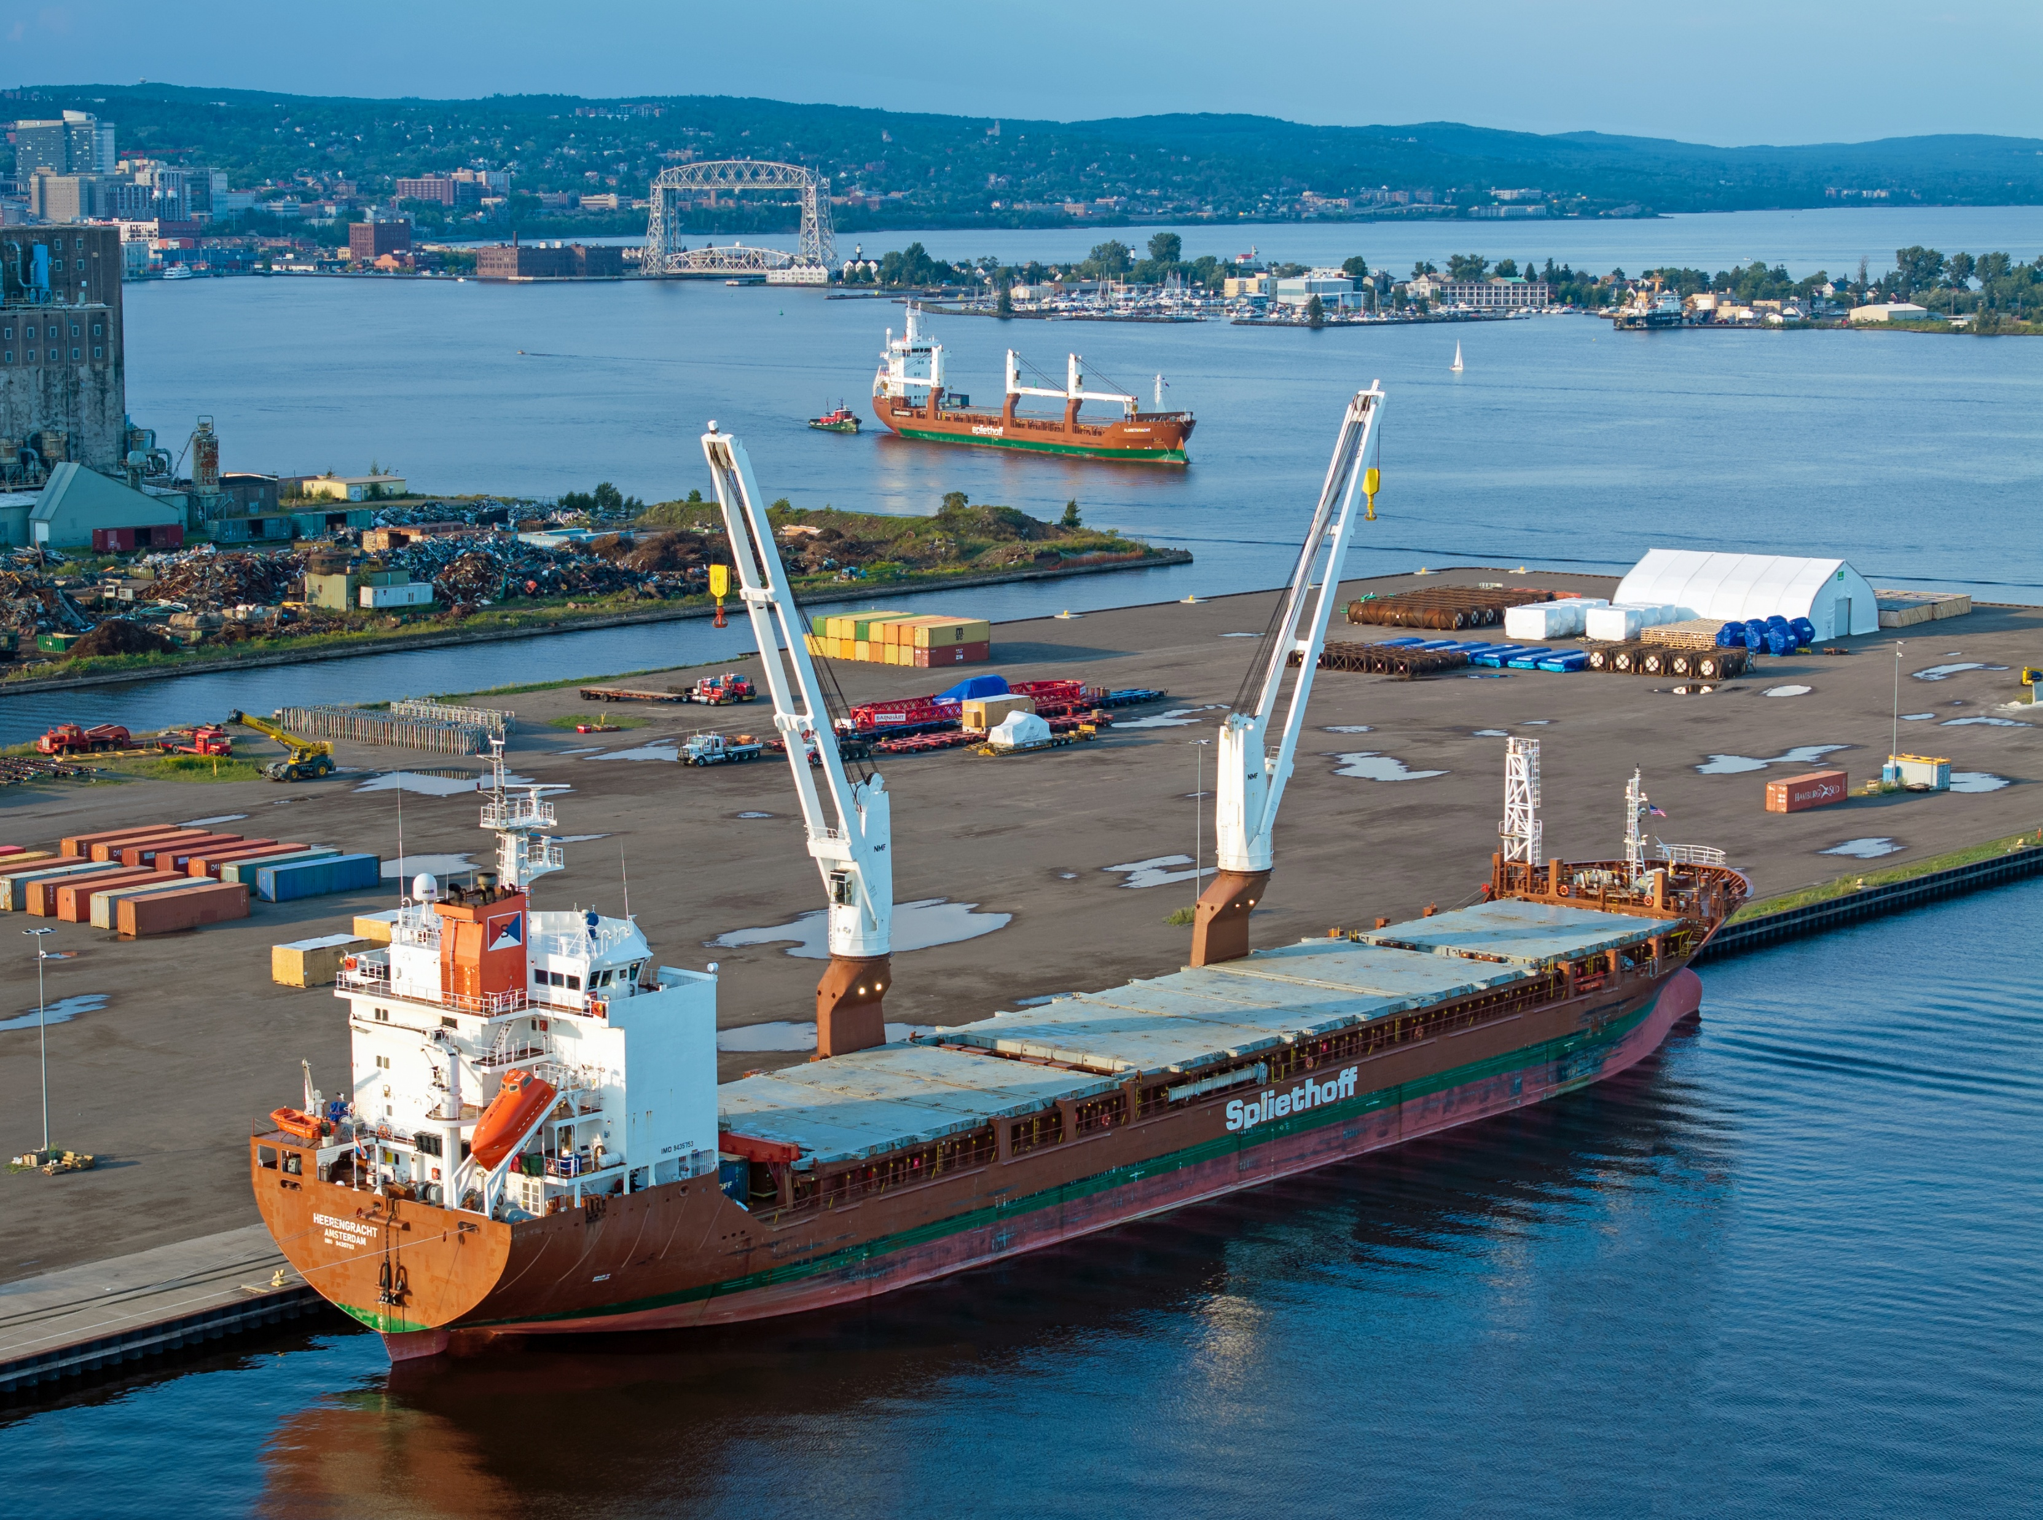

International Commerce
&
Mobility Forum
Hannah Fitzgerald
Counsellor for Trade Policy, Economic Security and Agriculture
British Embassy Washington
+1 202 299 4401

Slide 9

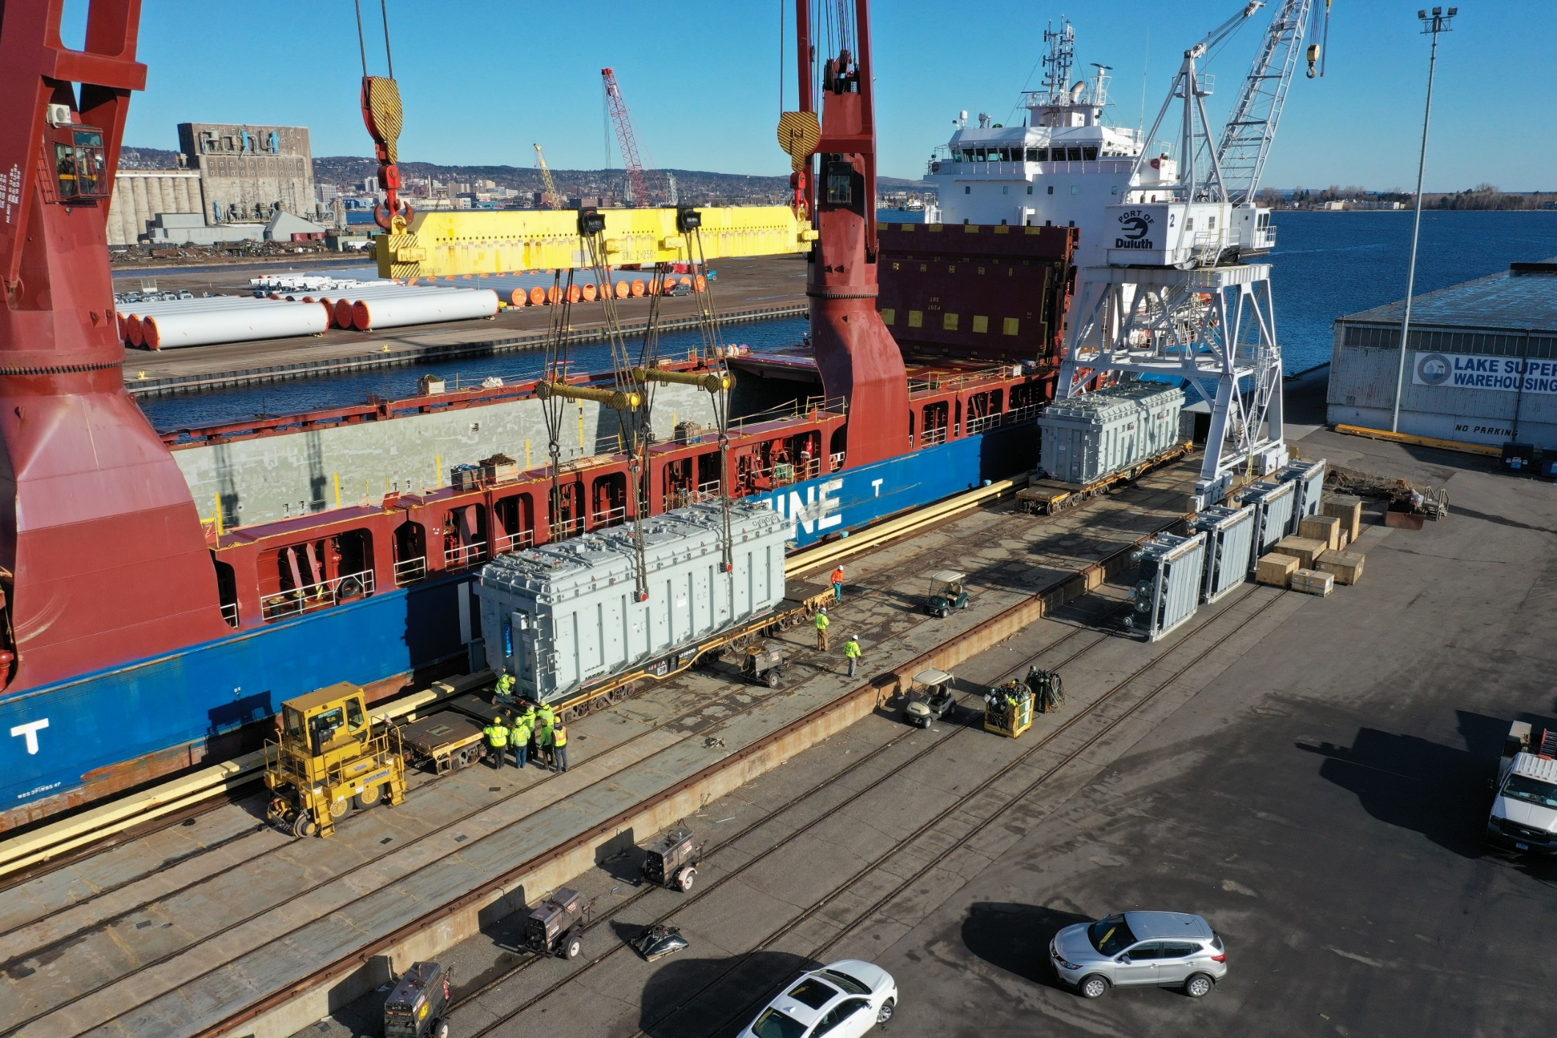
Overall Facility Features & Services
650,000+ SF of Warehouse Capacity
40 Acres of Outdoor Laydown Space
Foreign Trade Zone (FTZ) Designated
On-site USCBP Container Examination Station for Inspection of Import Containers
Large Fleet of Mobile Handling Equipment up to 300 Ton Capacity
On-Site Truck Scale
RO-RO Dock
Skilled and Experienced Workforce

Slide 10
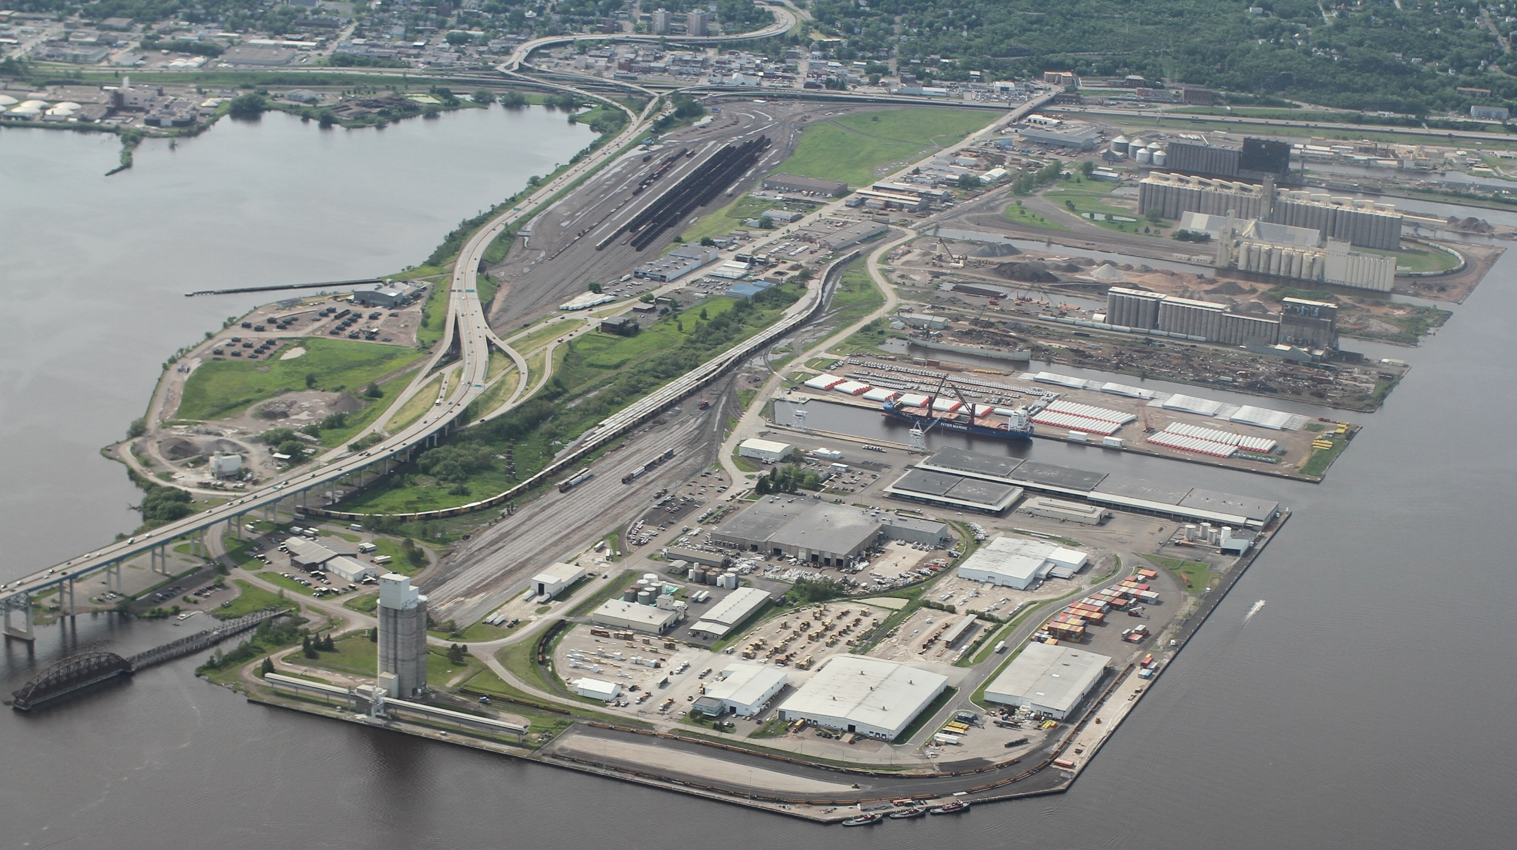
Facility Features – Transportation Connections
Ocean
Located on Great Lakes-St. Lawrence Seaway System for Access to Ocean Going Vessels
Rail
Direct Access to Four Class I Rail Carriers
  BNSF, CN, CPKC, UP
Highway
Close Proximity to I-35, US 53/US 2 Highway Corridors

Slide 11
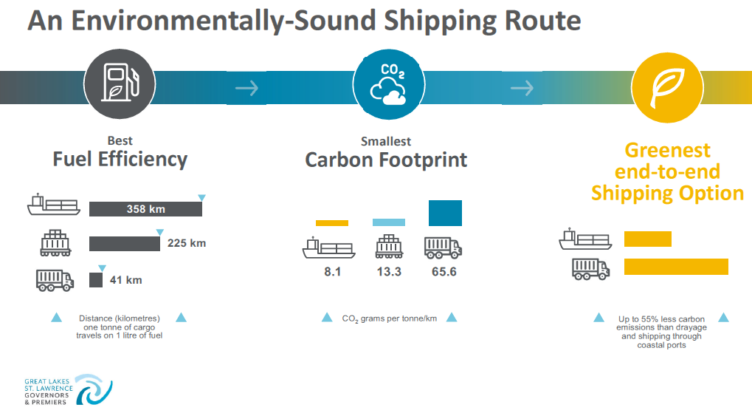



Slide 12

Fort McMurray
Edmonton
Calgary
Winnipeg
Billings
Fargo
Duluth/Superior
Minneapolis/St. Paul
Green Bay
Casper
Sioux Falls
Madison
Des Moines
Denver
Omaha

Slide 13
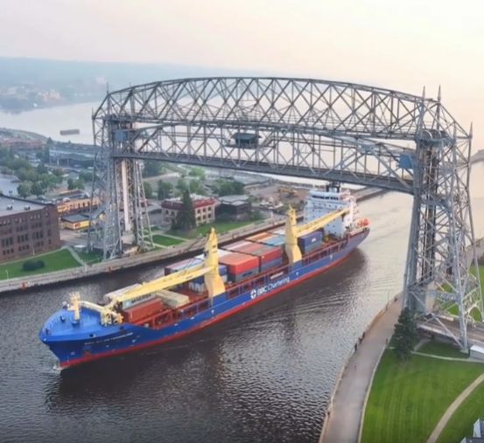
Thank you!
Jonathan Lamb
Duluth Cargo Connect
jonathan.lamb@duluthcargo.com
218-727-6646
Kate Ferguson
Duluth Seaway Port Authority
kferguson@duluthport.com
218-740-5422

