Slide 1
Minnesota Freight Network Optimization Tool (FNOT)
Briefing and Overview for the International Commerce & Mobility Forum
April 16, 2026
fnot.dot.state.mn.us

Slide 2
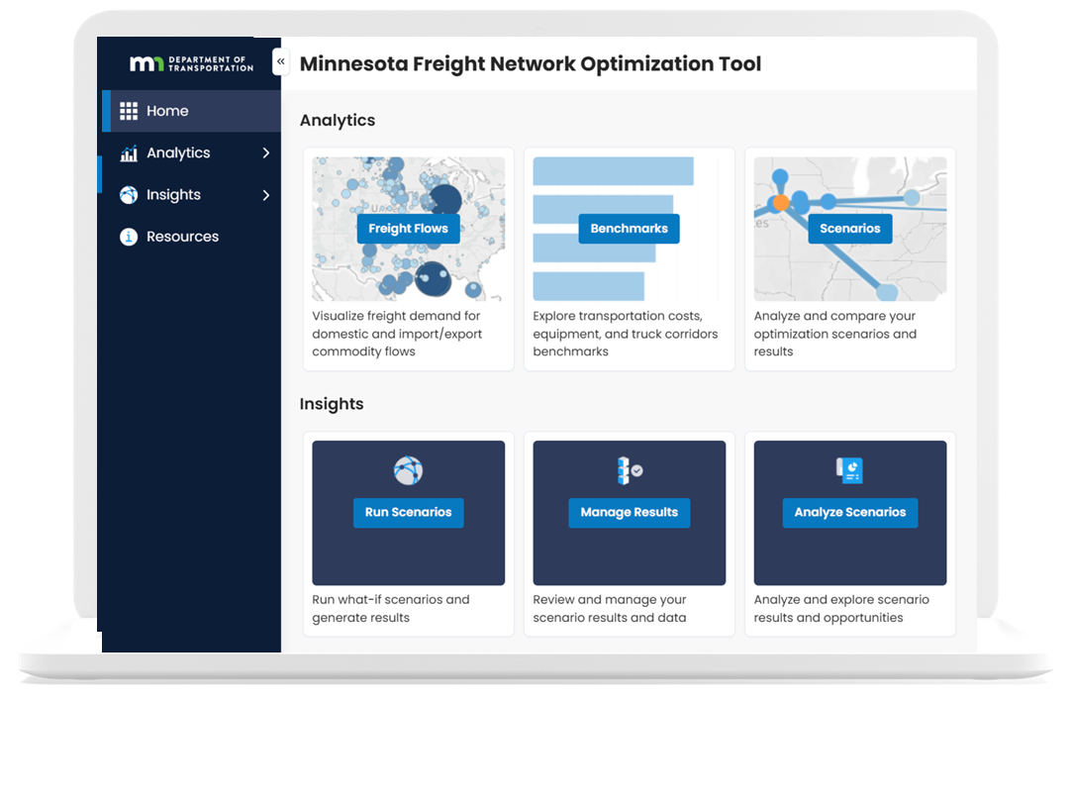
Agenda
FNOT Spring 2026 Update
Enhancement Highlights
  Updated baseline demand data
  Truck corridor benchmark visualization
  Transportation cost adjustment factor
FNOT Import/Export Enhancements

Slide 3


FNOT Project Timeline & Current Phase
Current Phase: Refining & Expanding the Prototype
2024 – 2025
Implementation
3Q25 - 4Q25
Launch
1Q26 – 2Q26
Prototype
3Q26 – 2Q27
Toward Full Production
Stakeholder outreach
Data development
Tool design & visualization
Tool launch
User training
Initial user feedback
Updated demand data to reflect current conditions
New corridor analysis tools
Ongoing user feedback and enhancements
Continued updates and enhancements
Increased user adoption
Expanded capabilities
Recent updates focus on maintaining current data, adding corridor-level insights, and enhancing overall usability.

Slide 4
FNOT Spring 2026 Update
What’s in the Release?
Why it Matters?
Freight Demand Data Updates
  Base year updated to 2023
  Forecasts updated to 2035 & 2050
New Capability
  Truck corridor visualization (commodity volume and value)
System Improvements
  Performance, usability, and modeling refinements
  Compatibility with latest browsers/devices
Reflects current freight patterns, including post-COVID conditions
Maintains relevant, up-to-date data for current and future analysis
Enables new corridor-level insights not previously available
Supports more informed planning and scenario evaluation

Slide 5
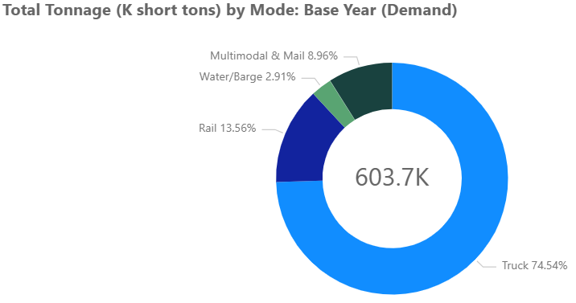

FNOT Demand Data Update: from 2019 to 2023
5.2% increase in tonnage
3.3% increase in ton miles
2% increase in emissions
2019
2023

Slide 6
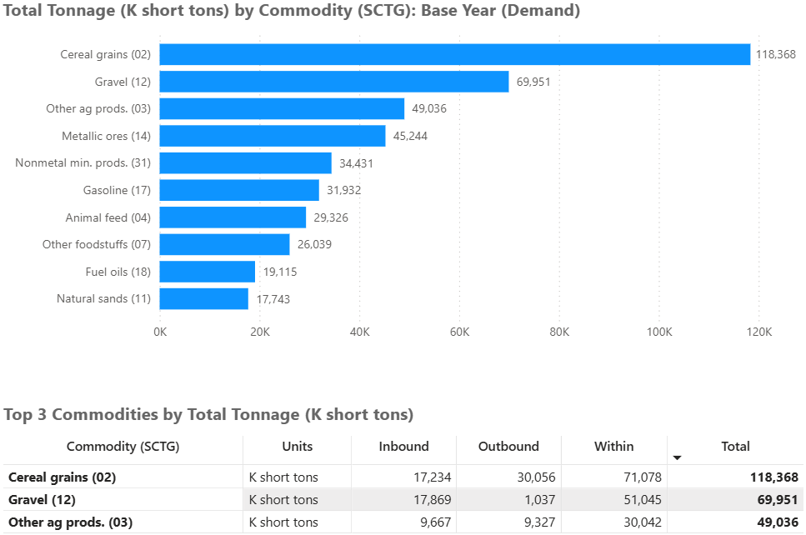
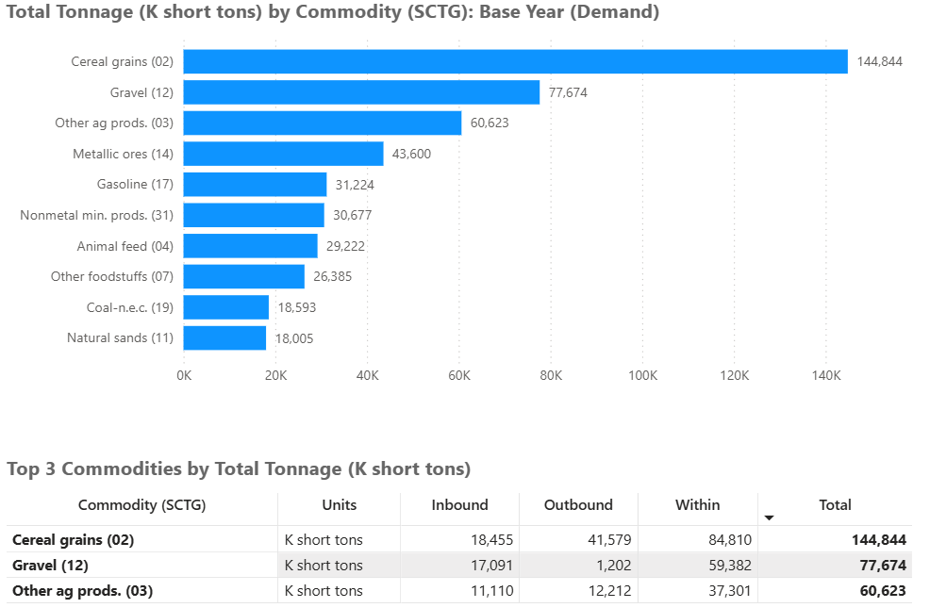
FNOT Demand Data Update: from 2019 to 2023
Change in Volumes for Top Commodities
2019
2023

Slide 7
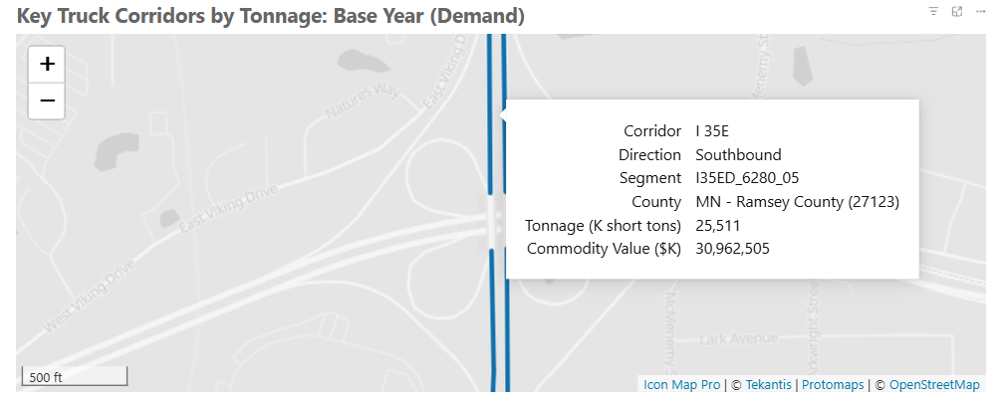
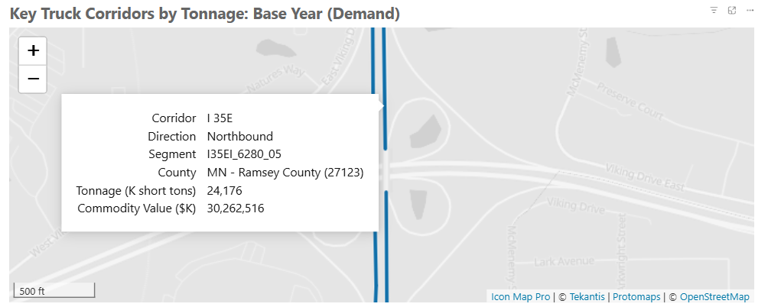
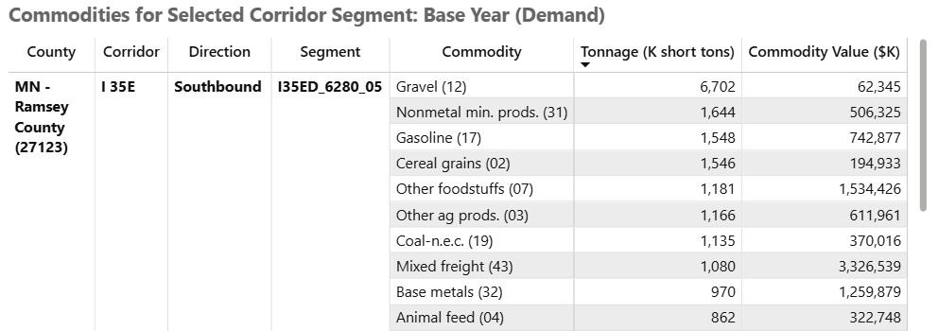

Truck Corridor Benchmark Enhancement
Select a corridor segment on the map to view detail by commodity

Slide 8
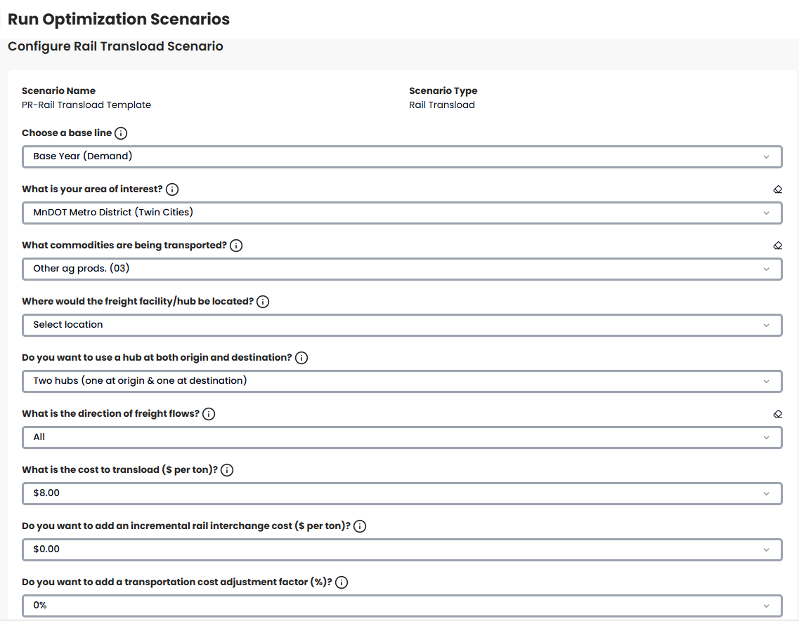
Transportation Cost Adjustment Factor Enhancement
To model changes in transportation costs, you can enter a cost adjustment factor. The factor is a percentage increase or decrease applied to all transportation costs in the scenario. To model costs without an adjustment factor, enter 0%.
Range from -5% to 25%

Slide 9
FNOT Import/Export Flow Enhancements
Imports
  107% increase for Electronics
  384% increase for Motorized vehicles & parts
  56% increase for Machinery
Exports
  195% increase for Ag. Prods.
  84% increase for Food Prods.
  259% increase for Mixed Freight

Slide 10
FNOT United Kingdom Imports & Exports
Total Imports
  130,200 tons
  $563.6 million
Total Exports
  78,000 tons
  $214.2 million

Slide 11
Minnesota Freight Network Optimization Tool (FNOT) fnot.dot.state.mn.us/
Questions
fnot.dot.state.mn.us

