Slide 1


Minnesota Multimodal Trade Platform – Why?
Exports are an economic driver
  $1 manufacturing spend = $2.69 in economic activity
  Export-focused job pay is 18% higher than domestic focused jobs
Minnesota
  2024 exports = $24.6 billion of manufactured products
  Supported 118 thousands jobs
  8,121 companies of which 86% small and mid-sized
  5.3% of MN GDP
  2024 export markets – Canada ($7.5 Bn), Mexico ($4.2 Bn), China ($2.0 Bn), Japan ($1.0 Bn) and Ireland ($782 Mn).
  Reduce leakage to ORD.

Slide 2
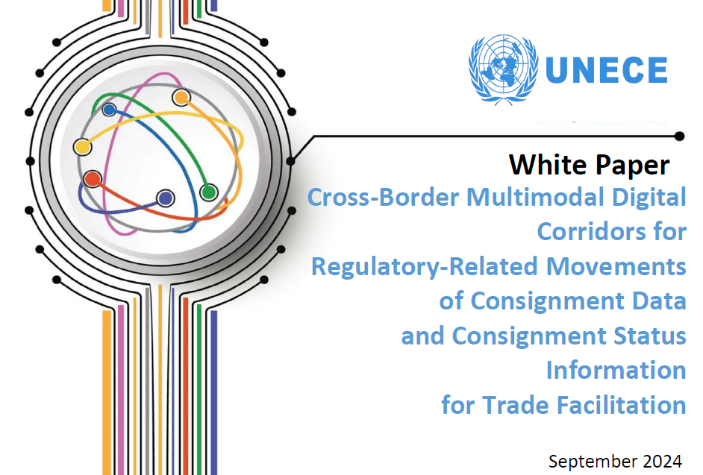

Minnesota Multimodal Trade Platform – Challenges to Trade
Cargo community systems and digital corridors – a platform for cross-border transactions – speed up consignment flows.
Reduce repetitive consignment data entry.
Reduces consignment information and data errors.
Ensures security of the borders.
Applicable duties and taxes are collected in a transparent manner.

Slide 3
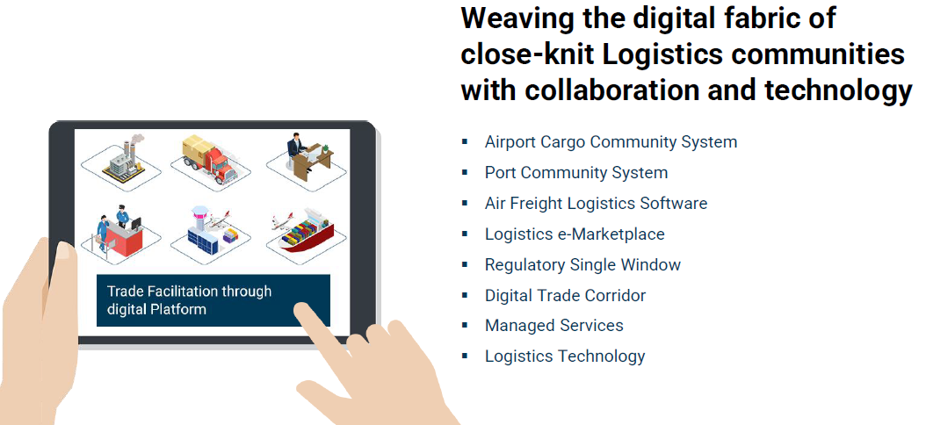

Minnesota Multimodal Trade Platform - Concept

Slide 4
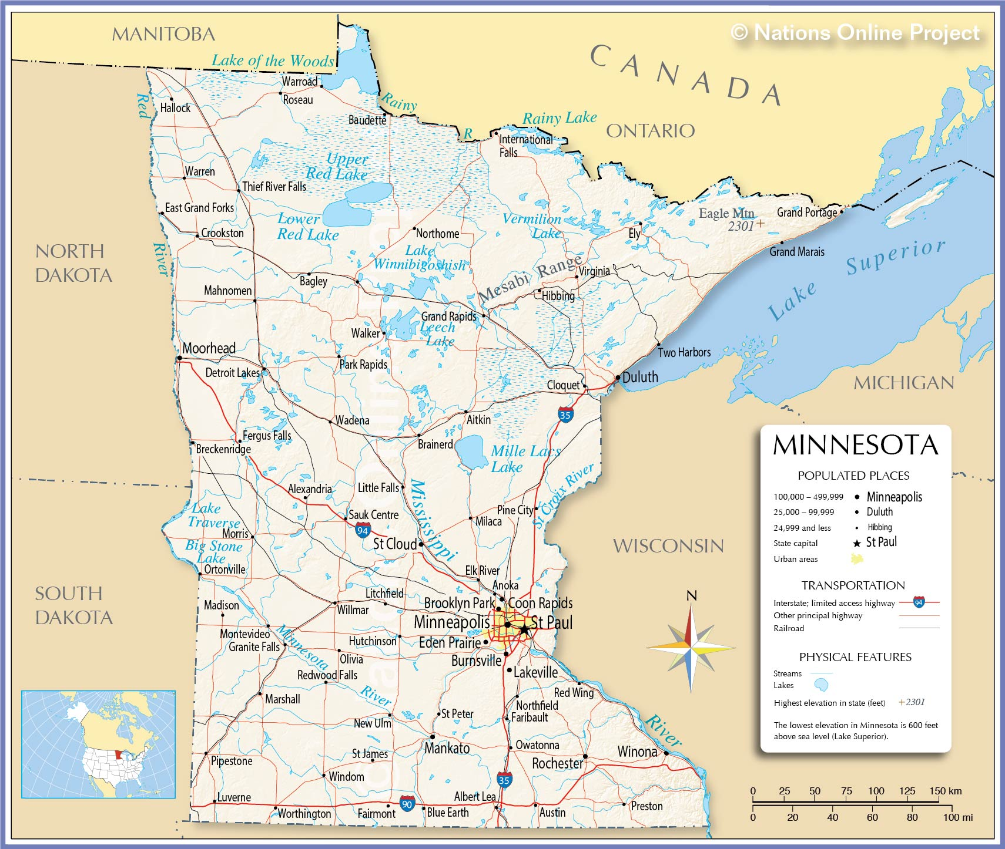

Minnesota Multimodal Trade Platform
(Potential Locations)
Airport Marine port
Road/Rail port

