Slide 1
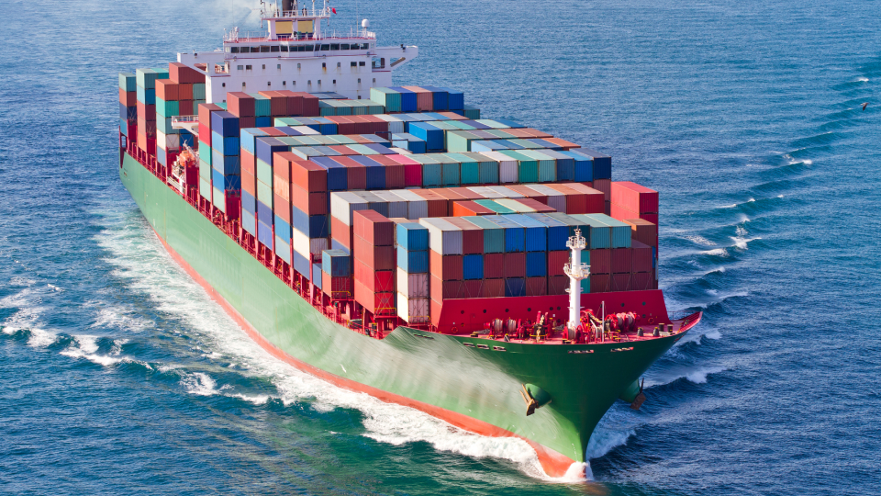
UK - US Trade Resiliency
Leveraging the Great Lakes
St. Lawerence Seaway
Jan Bauer, Consul
UK Government Office, Minnesota
Jan.Bauer@fcdo.gov.uk

Slide 2
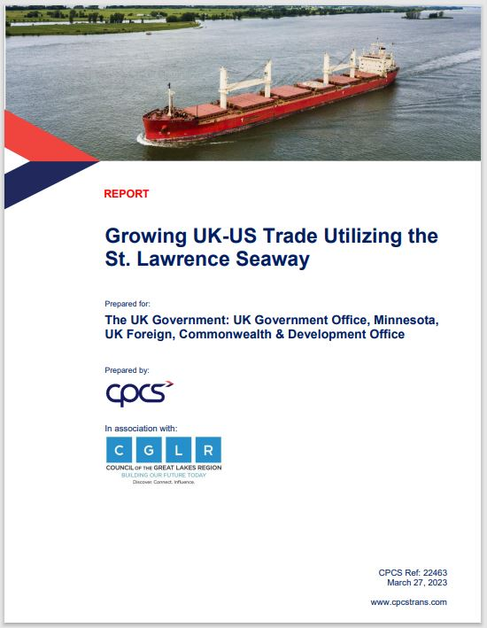
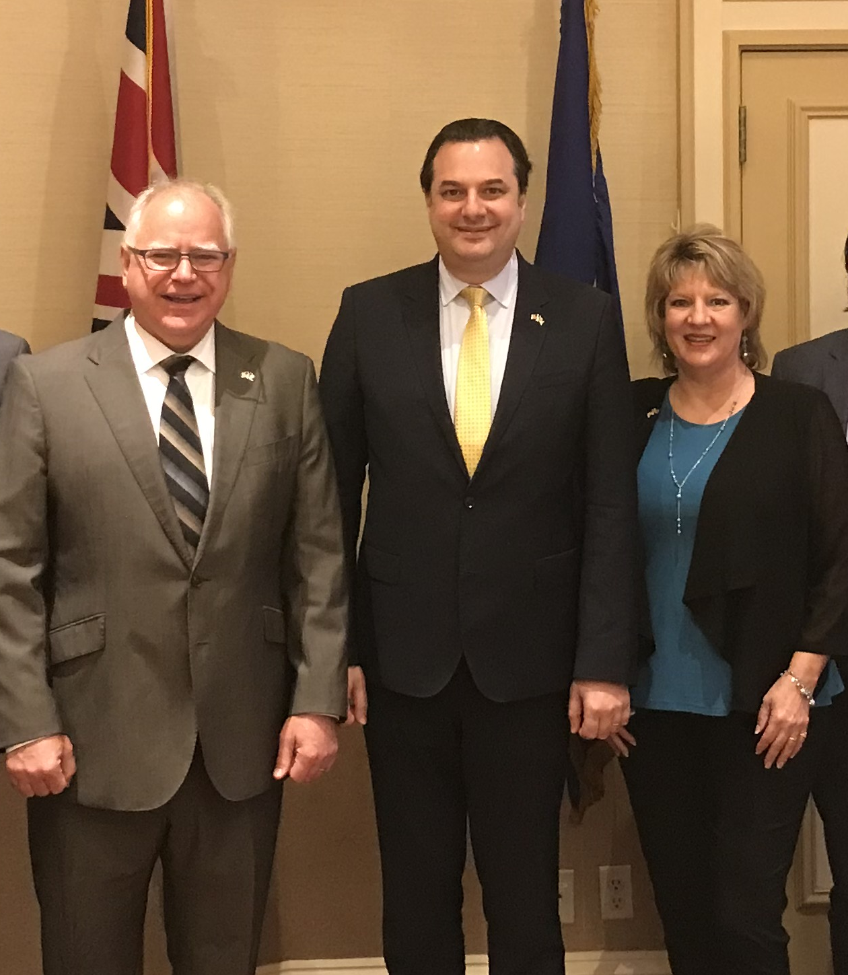
Minnesota Governor
June 2021
Gov. Walz, CG Gogbashian, Consul Bauer
Port of Duluth is 50% Underutilized
and has the capacity
UK Commissioned Report Fall 2022

Slide 3

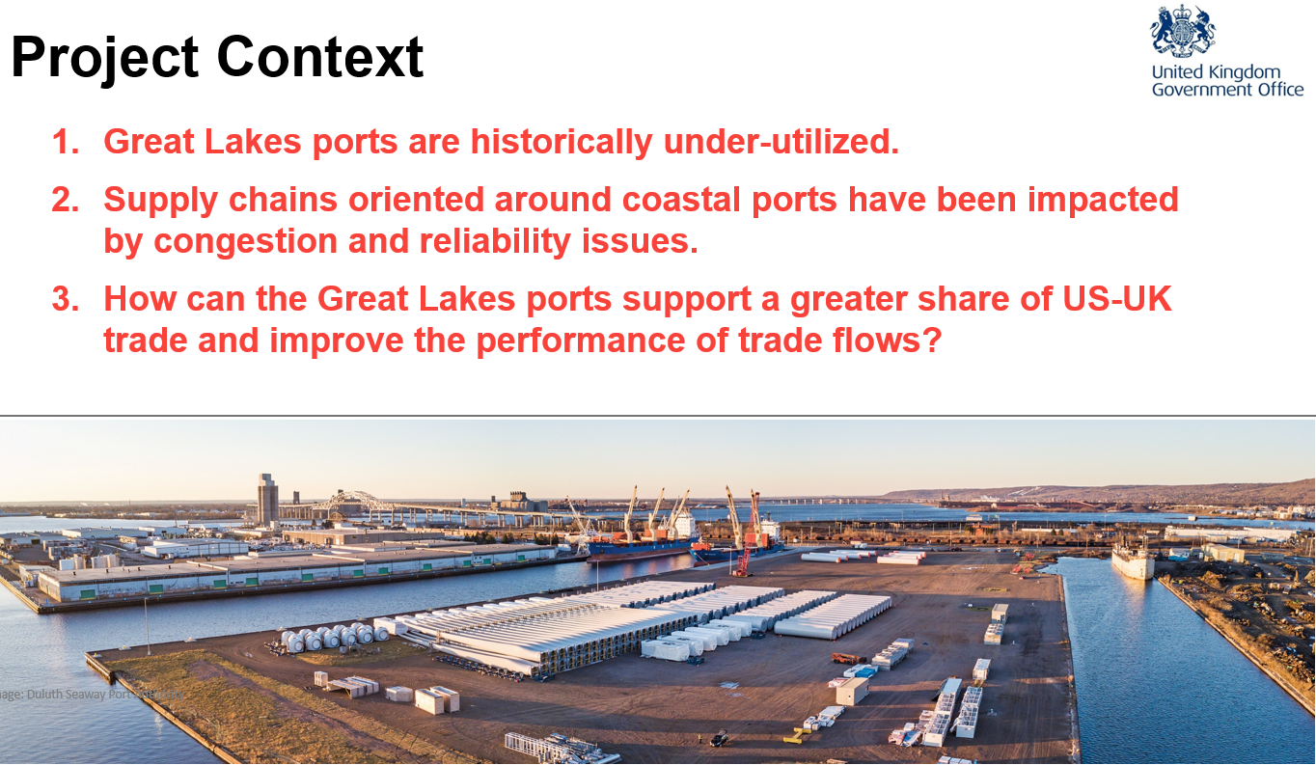
Report Context
Great Lakes Seaway are historically under-utilized
Supply chains oriented around coastal ports are impacted by congestion & reliability issues
How can the Great Lakes Ports support a greater share of the UK/US trade and improve performance of trade flows?

Slide 4
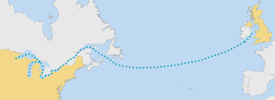
Establish a Regular UK/US Trade Route via the
Great Lakes SLS – a Green Shipping Corridor
The St. Lawrence Seaway provides a direct maritime connection
Better utilize of the GL SLS system for UK-US trade
Improve the smooth efficient movement of goods while reducing carbon emissions

Slide 5
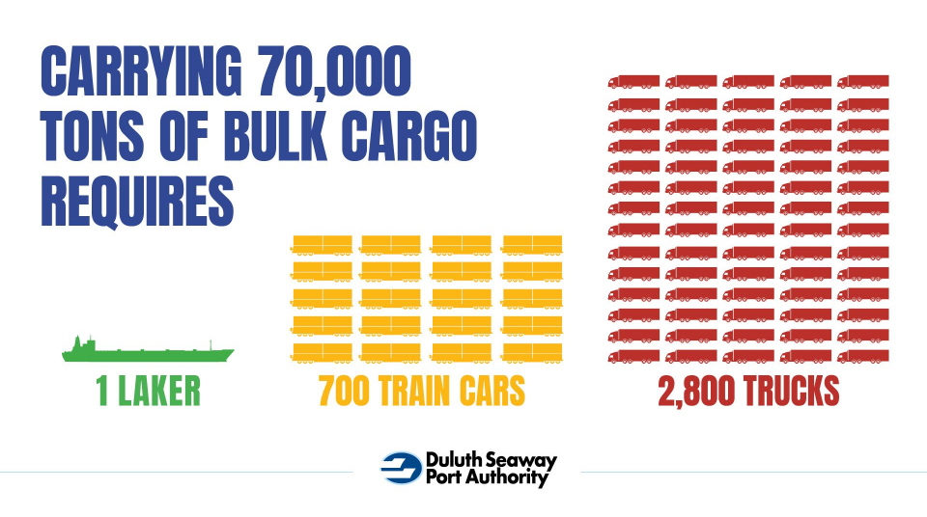
Green Shipping Corridor

Slide 6
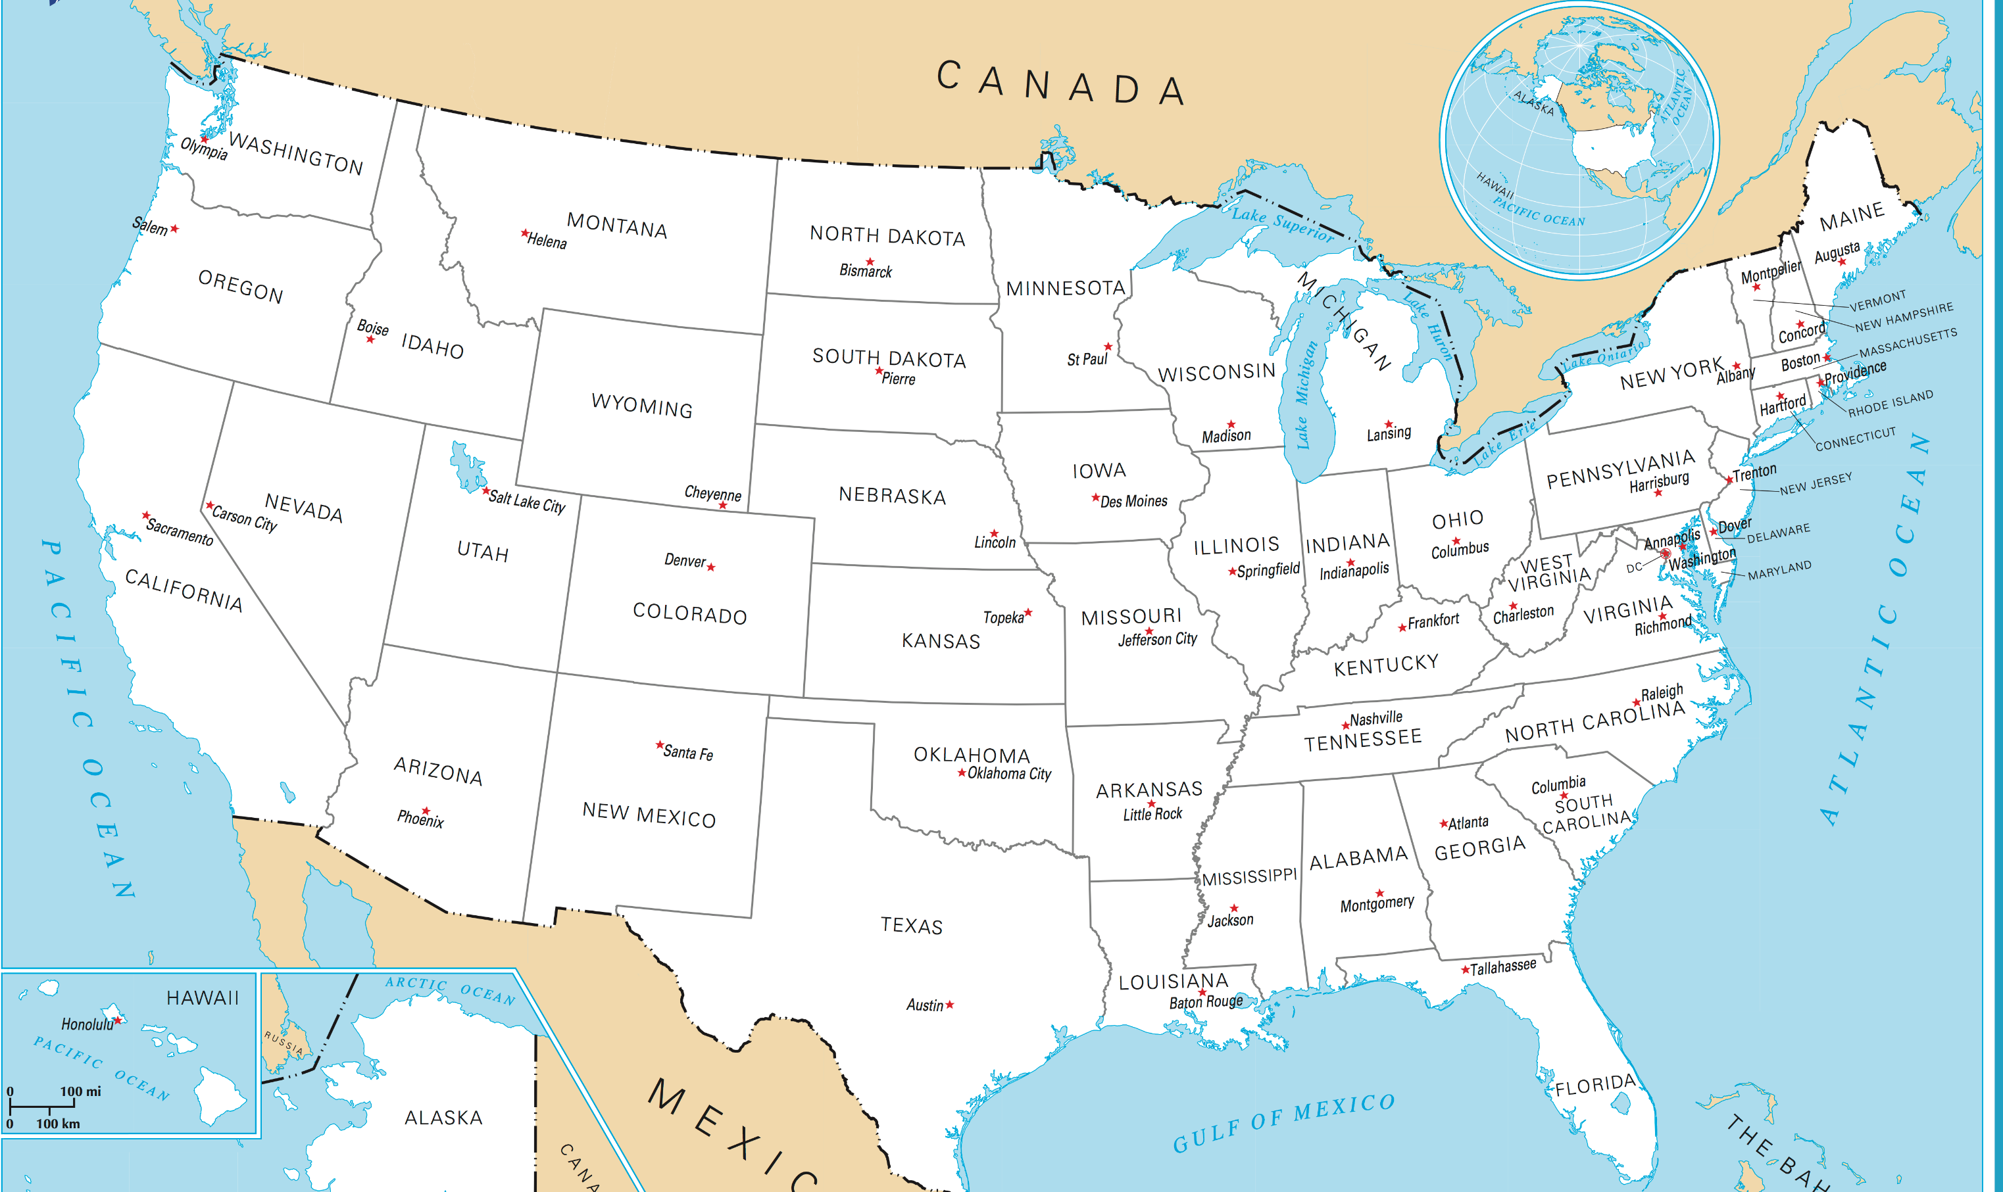
Taking Advantage of an efficient Green Trade Route
Duluth
Cleveland

Slide 7

Key Points Review
UK and US Governments support this effort
Resiliency & Redundance- a supply chain insurance policy
  Develop a supply chain with versatility, resiliency & redundancy in an already challenged supply chain.
Green Your Supply Chain
  40-60% CO2 reductions, depending on mode and route (reducing rail and/or truck)
  Unique value proposition: Stand out as a company who can demonstrate they are reducing their carbon footprint
Improved door-to-door travel times - avoiding coastal port congestion
  Cleveland to UK - 7-10 days vs 2-3 weeks
  Duluth to UK - 2 weeks vs 4-6 weeks via east coast ports.
  Cash is King! $ Goods in consumers hands faster means sellers get paid faster
Challenges
  Smaller Ships required (Handi-Max) to fit through 15 Locks
  Closure mid-January to mid-March for lock maintenance

Slide 8
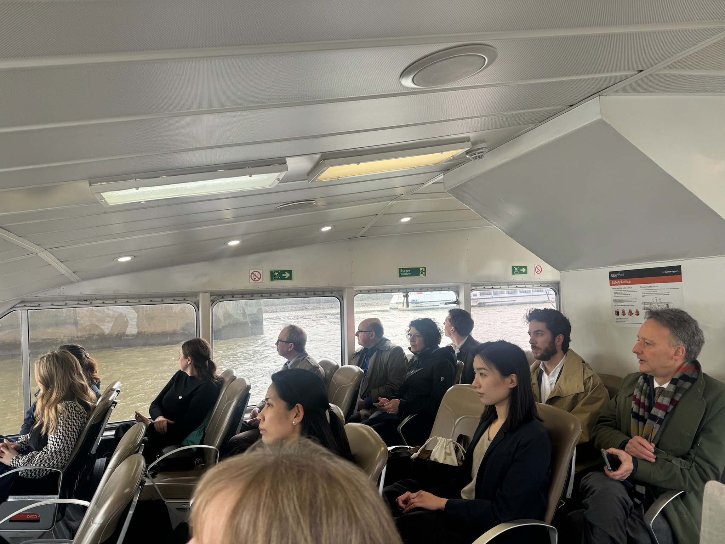
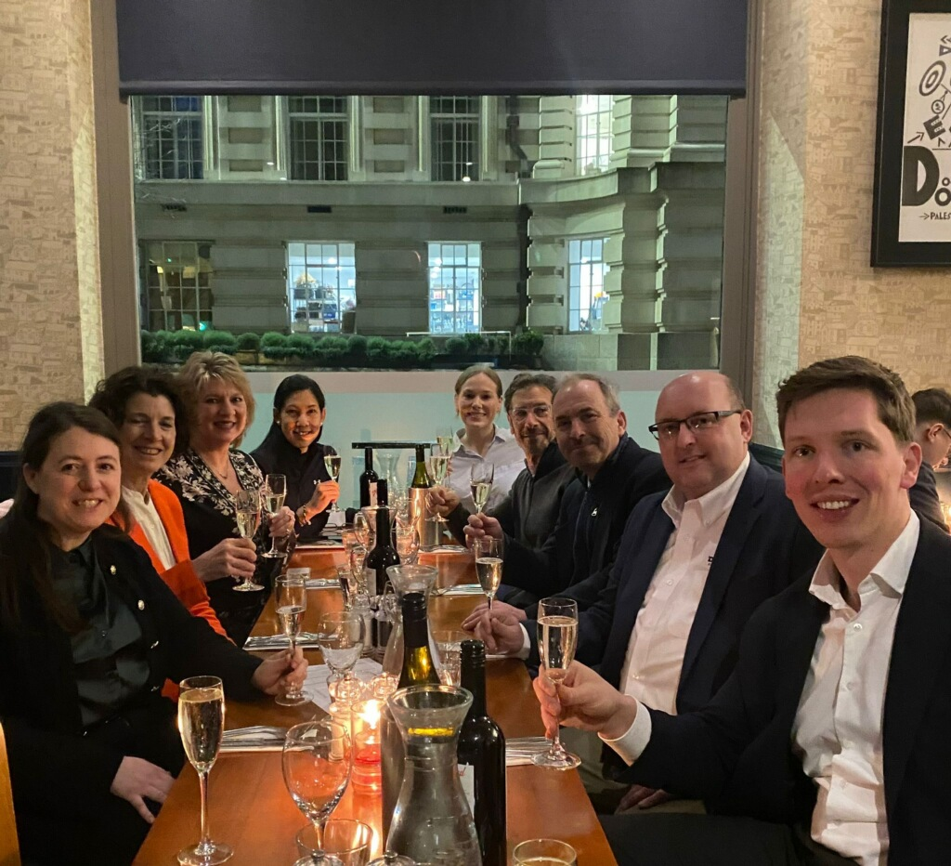
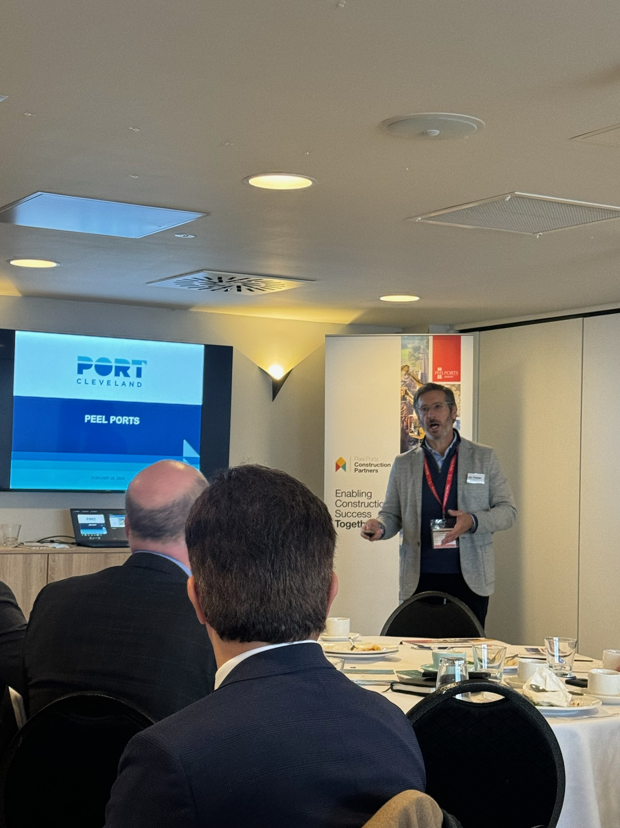
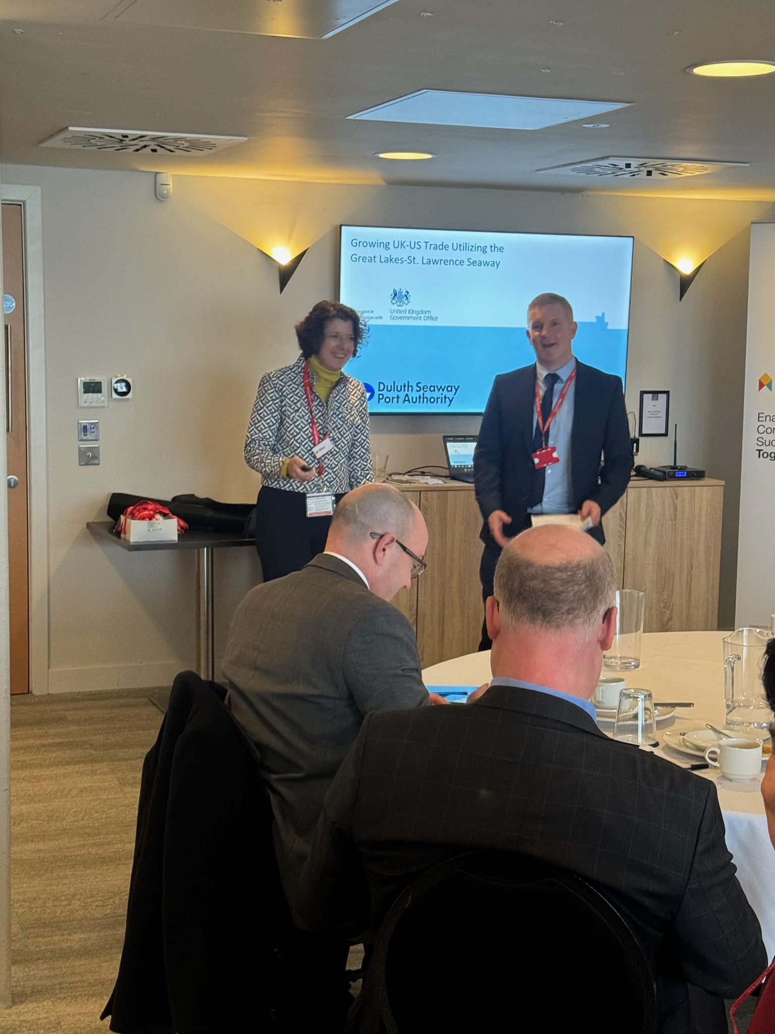
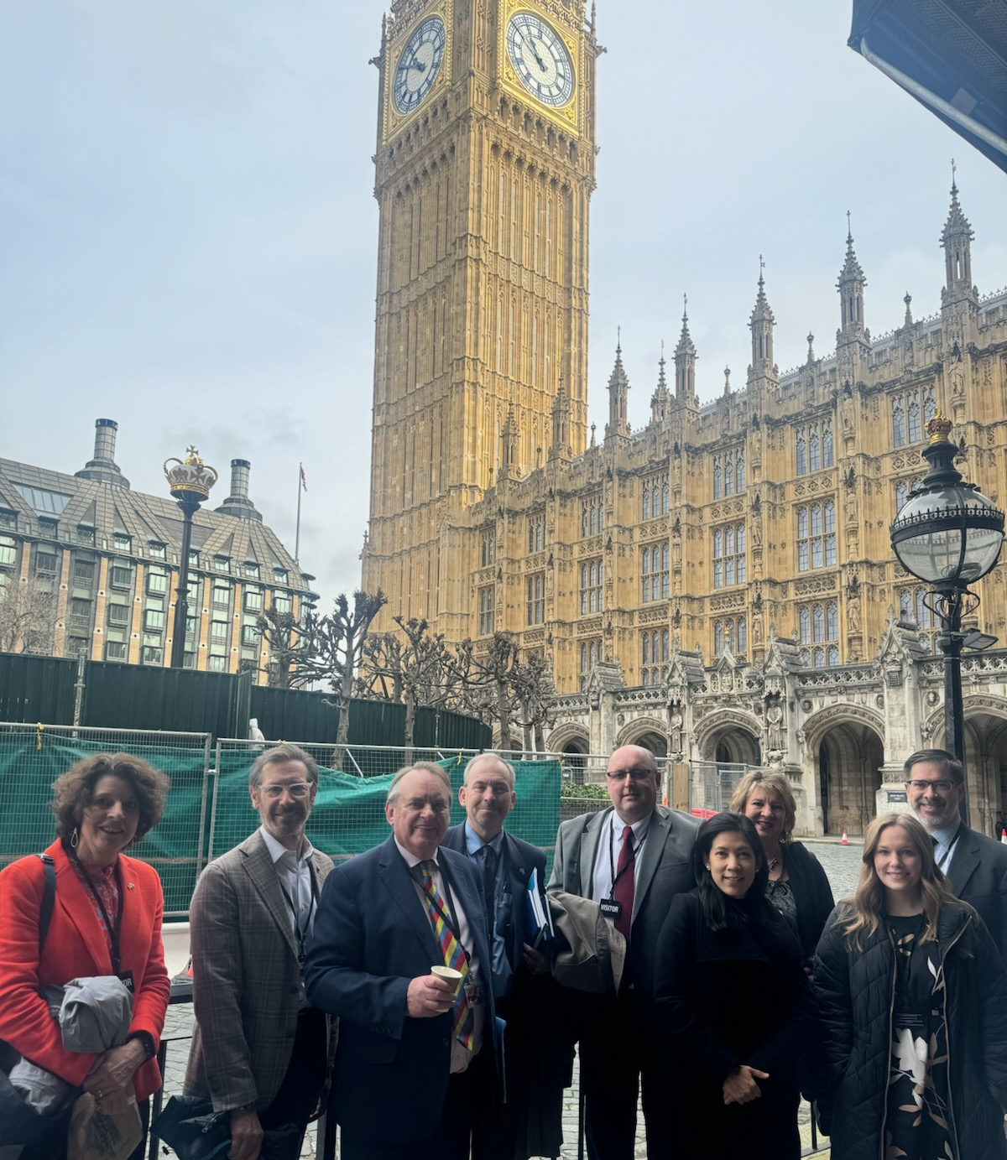
Ports of Cleveland & Duluth present
to supply chain leaders at the Port of Liverpool
Thames Estuary & DP World Visit
US Delegation to the UK February 2024

Slide 9
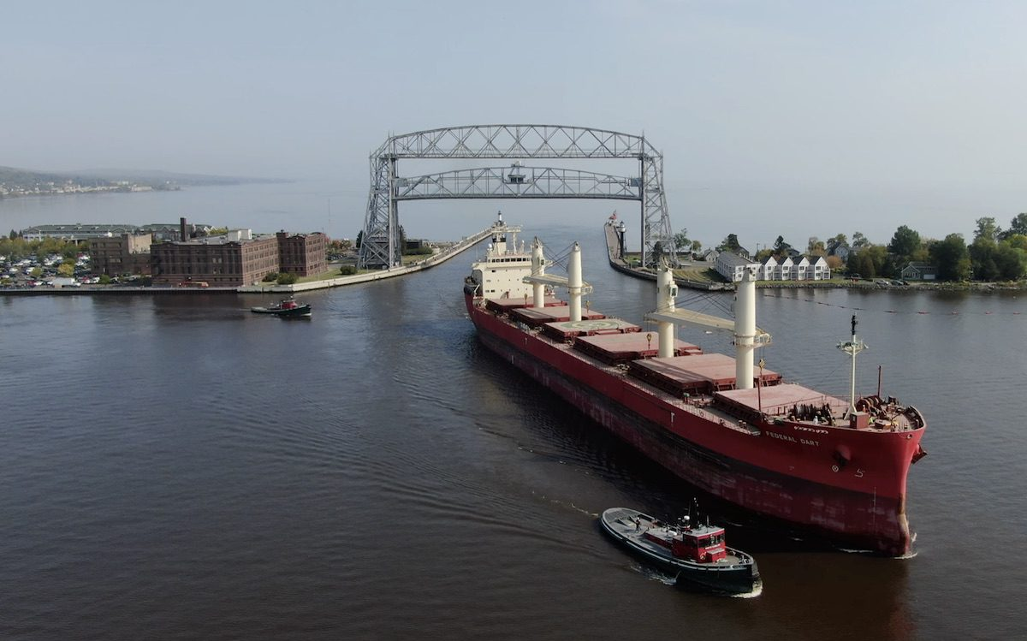
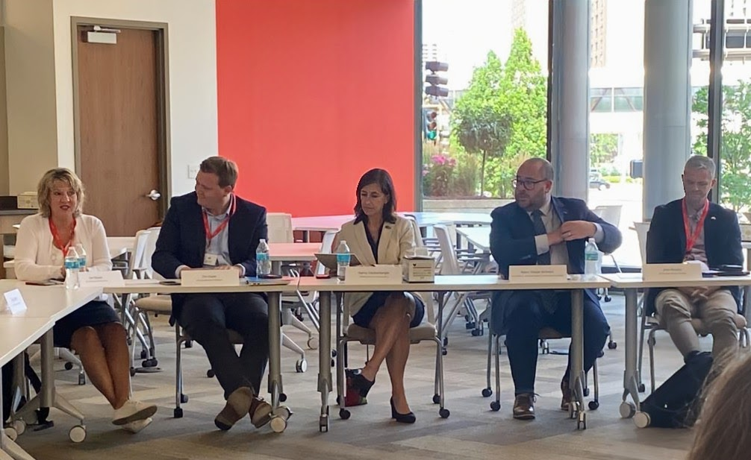
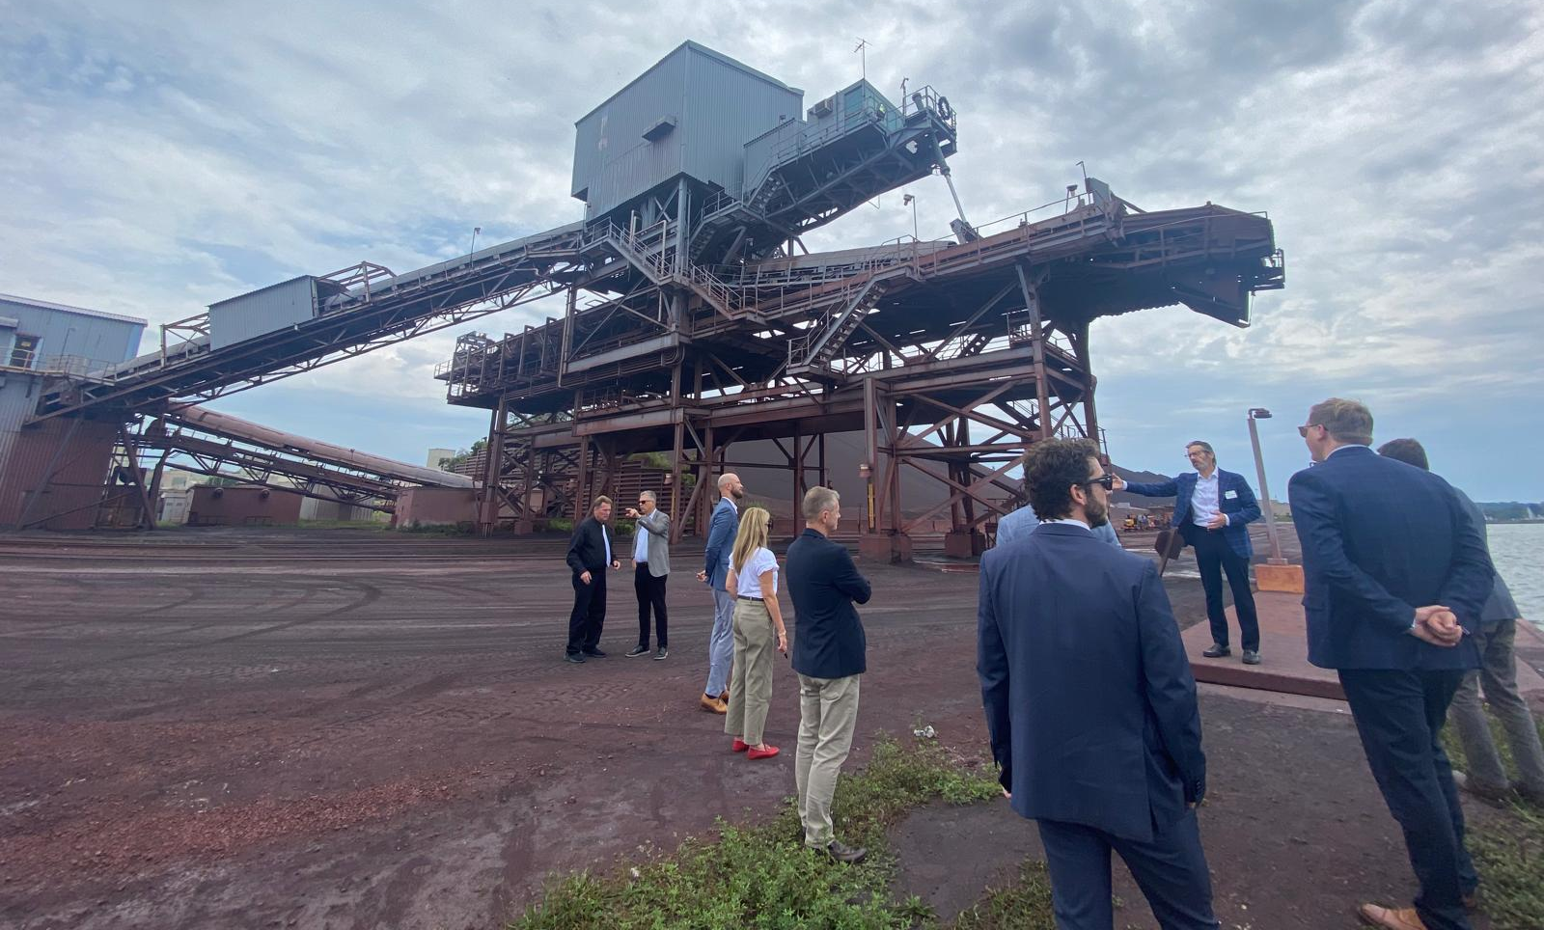
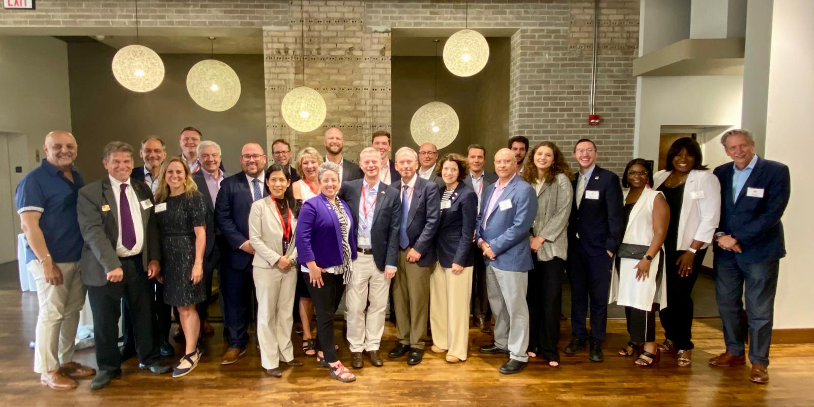
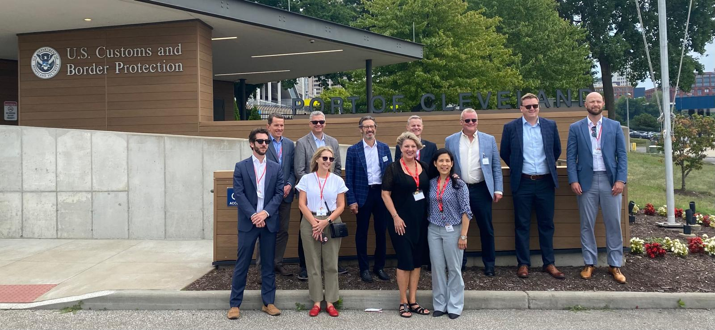
UK Visit to the US July 2024
Cleveland OH, Duluth MN & Minneapolis MN

Slide 10
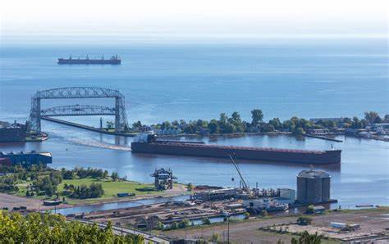
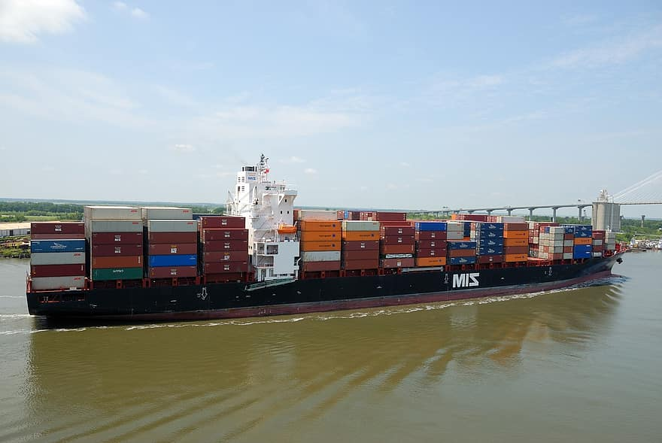
Next Steps:
Continue dialogs with multipliers
  Joint Effort UK/US Stakeholders
    Freight Forwarders
    Exporters
    Shipping associations
    Carriers
London International Shipping Conference
  September 2025
  US/UK team

Slide 11

Thank You
Jan Bauer, Consul
UK Government Office, Minnesota
Jan.Bauer@fcdo.gov.uk

